Slide 1




















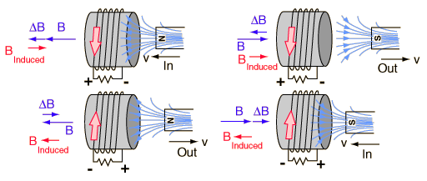






Lenz’s Law
When an emf is generated by a change in magnetic flux according to Faraday’s Law, the polarity of the induced emf is such that it produces a current whose magnetic field opposes the change which produces it.
The induced magnetic field inside any loop of wire always acts to keep the magnetic flux in the loop constant.
In the examples below, if the magnetic field B is increasing, the induced magnetic field B acts in opposition to that increase.
If the magnetic field B is decreasing, the induced field B acts in the direction of the applied field to try to keep it constant.

Slide 2


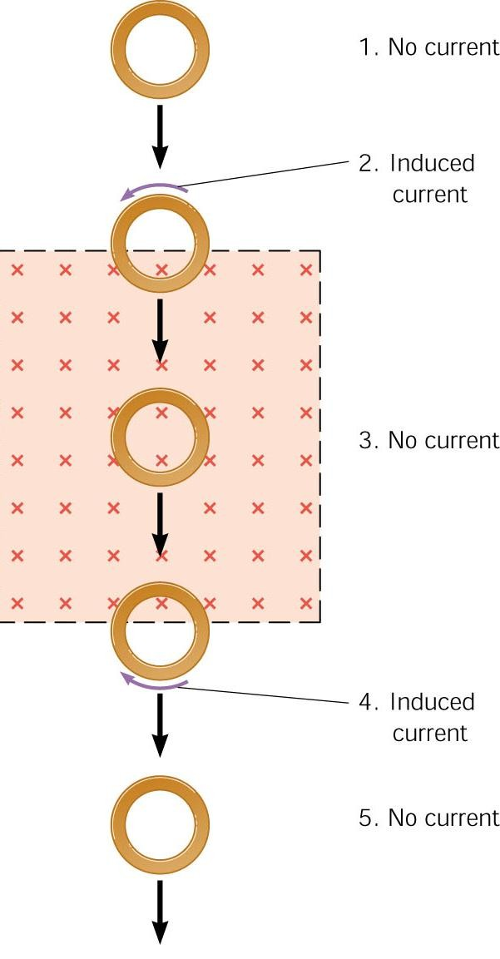


















A copper ring passes through a rectangular region where a constant magnetic field is directed into the page. The picture shows that a current is induced in the ring at locations 2 and 4.
No current b/c no flux since no
magnetic field, B=0.
Flux increases. External B points into page, so I must move to create a B that offsets this flux increase. I moves ccw to counter increase in flux.
Flux is not changing (B is constant, A is constant, angle is constant), so I is NOT induced.
Flux decreases. External B points into page, so I must move to create a B that offsets this flux decrease. I moves cw to counter decrease in flux.
B=0, so no magnetic flux. No current.

Slide 3


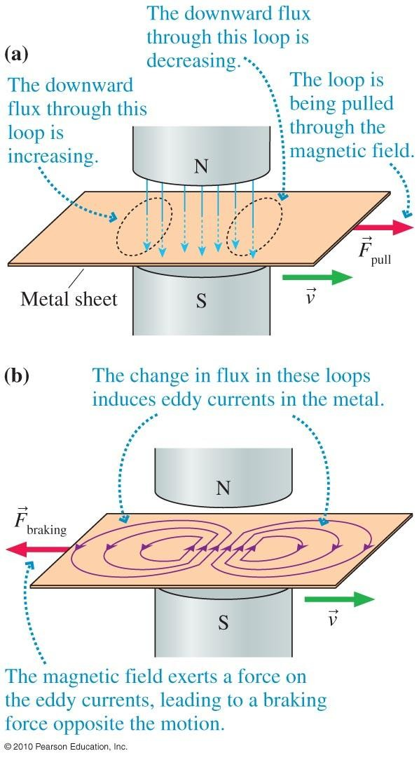













Eddy Currents
As the copper plate is pulled to the right there are circular currents induced in the plate.
If you use the RHR and point thumb in the direction of current in the center of the plate what is the direction of magnetic force?

Slide 4
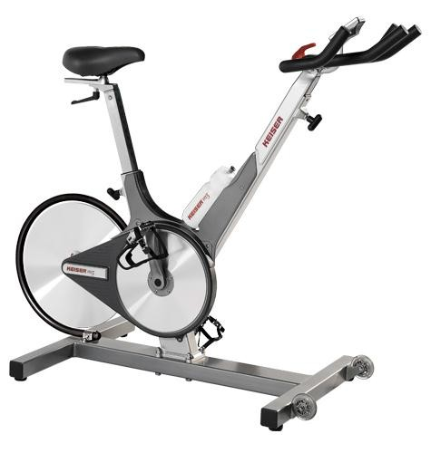
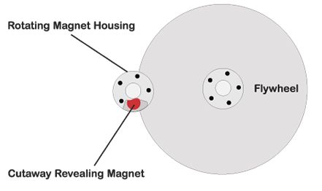
Eddy currents in bike.

Slide 5









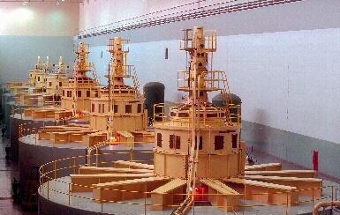
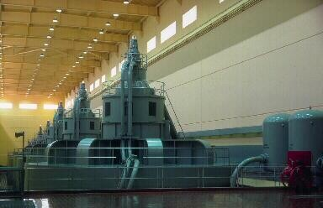
Electric Generators: supply electrical energy by producing an induced emf according to Faraday’s law of electromagnetic induction
http://ga.water.usgs.gov/edu/hyhowworks.html http://www.wvic.com/hydro-works.htm http://www.wvic.com/how-gen-works.htm http://people.howstuffworks.com/hydropower-
plant2.htm

Slide 6

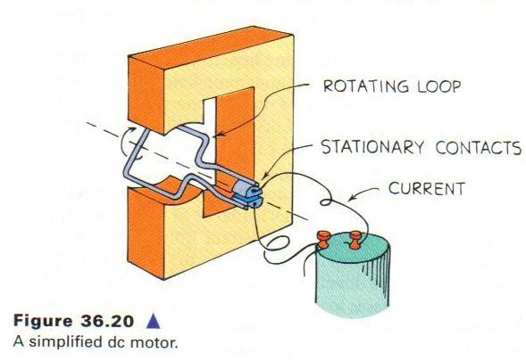











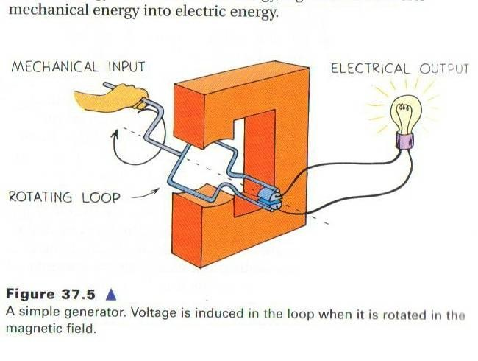






A motor converts electrical energy into mechanical energy.
A generator converts mechanical energy into electrical energy.
In a motor, an input electric current causes a coil to rotate, thereby doing mechanical work on any object attached to the shaft of the motor.

Slide 7





In a generator, the shaft is rotated by some mechanical means, such as an engine or turbine, and an emf is induced in a coil.
If the generator is connected to an external circuit, an electric current is the output of the generator.

Slide 8










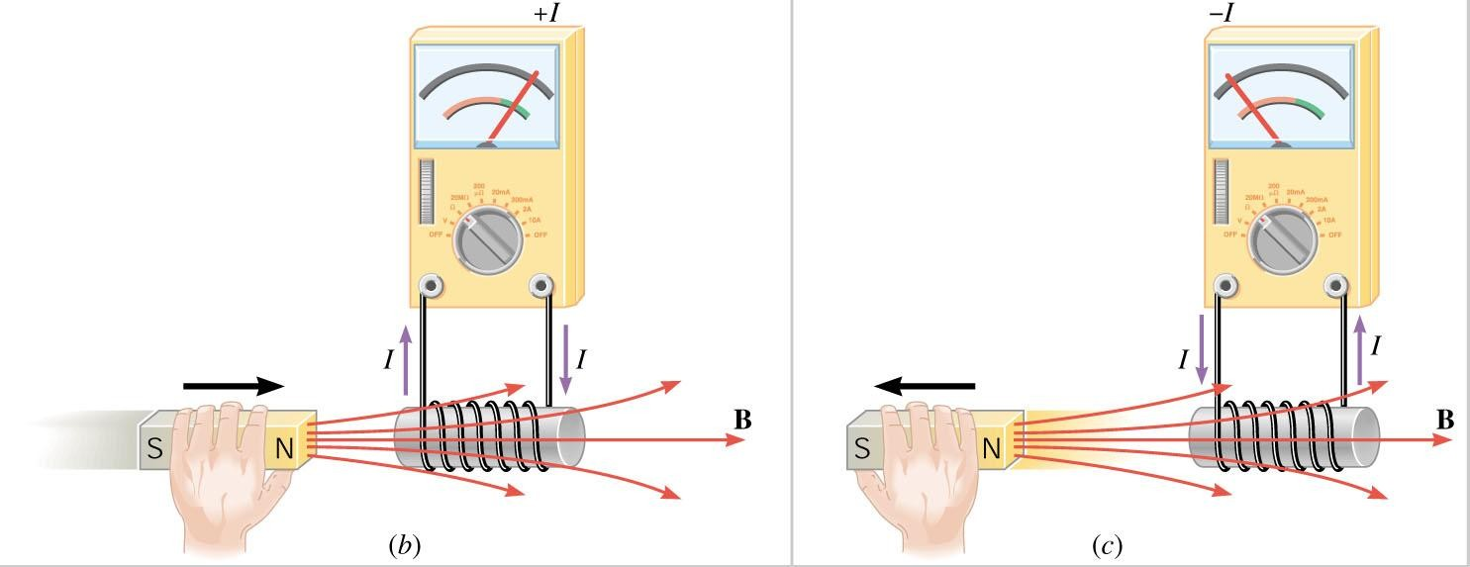
If one end of a magnet is plunged in and out of a coil of wire, the induced voltage alternates in direction. As the magnetic field strength inside the coil is increased (magnet entering), the induced voltage in the coil is directed in one way. When the magnetic field strength diminishes (magnet leaving), the voltage is induced in the opposite direction.
When the voltage changes direction, so does the current.
Lenz’s law basically states that the moving magnetic field will induce a current that produces its own magnetic field opposite in direction to the change in magnetic flux.
The greater the frequency of field change, the greater the induced voltage (move the magnet faster➔greater emf).
The frequency of the induced alternating voltage equals the frequency of the changing magnetic field within the loop.

Slide 9

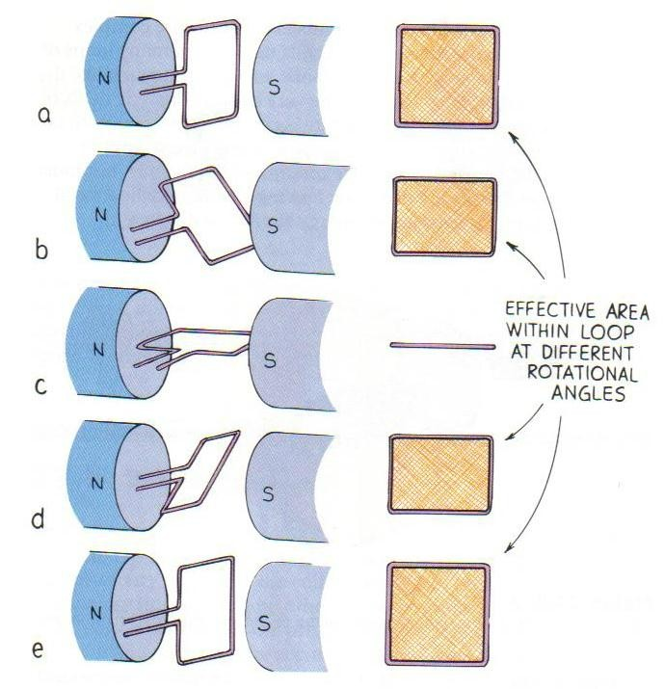











Rather than moving the magnet, it is more practical to move the coil.
This is best accomplished by rotating the coil in a stationary magnetic field.
This arrangement is called a generator.
A generator converts mechanical energy into electric energy.

Slide 10
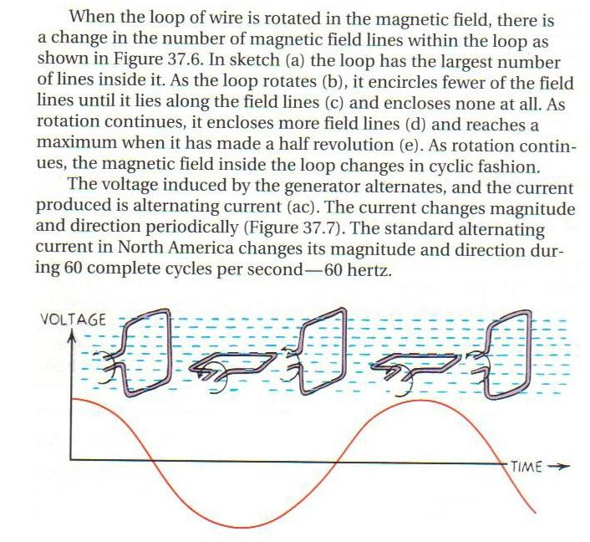

Slide 11
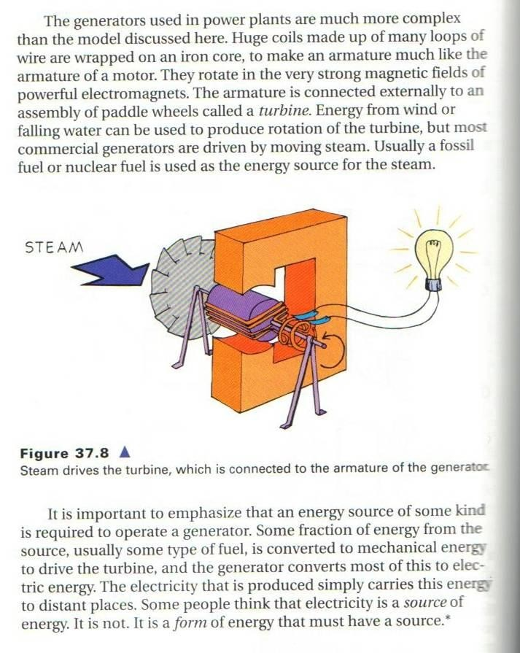

Slide 12
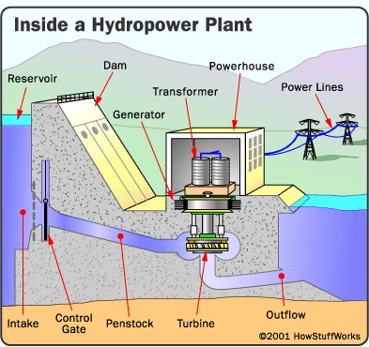

Slide 13
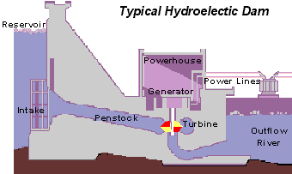
The theory is to build a dam on a large river that has a large drop in elevation (there are not many hydroelectric plants in Kansas or Florida). The dam stores lots of water behind it in the reservoir. Near the bottom of the dam wall there is the water intake. Gravity causes it to fall through the penstock inside the dam. At the end of the penstock there is a turbine propeller, which is turned by the moving water. The shaft from the turbine goes up into the generator, which produces the power. Power lines are connected to the generator that carry electricity to your home and mine.
The water continues past the propeller through the tailrace into the river past the dam. By the way,
it is not a good idea to be playing in the water right below a dam when water is released!

Slide 14
